Slide 1
CMP101: Introduction to Computer Science (3 units) All You Need to Know About Python Programming Language
Mr. M. Yusuf

Slide 2
Course Outline
Introduction
Flowcharts
How to write Projects Rprt
Introduction to python
Syntax
Comments
Variables
Data types
Strings (concat, slice)
Numbers
Casting
Operators/Operands
Array []
Lists []
Tuples ()
Dictionaries {}
Control Structures
If… elif…
Counting
Summing
Swapping
Max and min
Loops
For Loops
While Loops (break, cont. pass)
Switch… case
Functions (arg, param, loc/glob)
Built in
User define
OOP: Class, Object, Inheritance
Modules
Regular Expressions
Exceptions
Files (Read, write, delete)
Iterators and Collections Modules
Frameworks
GUI,
Mobile,
Web,
IoT,
AI

Slide 3
What is Python
Python is a scripting interpretive Programming Language (PL)
Created by Guido van Rossum, and released in 1991
Multiplatform, can work on Raspberry P, windows, Mac, Linux etc
High Level Language easy to use
Rich and available Application Programming Interfaces (API)
Procedural, Functional and OOP PL
Relies on indentation instead of curly-brackets
Versions 2 and 3
Python is use for
Web application development
Mobile application development,
Artificial Intelligence
Internet of Things (IoT).
GUI application development

Slide 4
Features of Python
no compiling or linking | rapid development cycle
no type declarations | simpler, shorter, more flexible
automatic memory management | garbage collection
high-level data types and operations | fast development
object-oriented programming | code structuring and reuse, C++
embedding and extending in C | mixed language systems
classes, modules, exceptions | "programming-in-the-large" support
dynamic loading of C modules | simplified extensions, smaller binaries
dynamic reloading of C modules | programs can be modified without stopping
Lutz, Programming Python

Slide 5
Features of Python Cont.
universal "first-class" object model | fewer restrictions and rules
run-time program construction | handles unforeseen needs, end-user coding
interactive, dynamic nature | incremental development and testing
access to interpreter information | metaprogramming, introspective objects
wide portability | cross-platform programming without ports
compilation to portable byte-code | execution speed, protecting source code
built-in interfaces to external services | system tools, GUIs, persistence, databases, etc.
Lutz, Programming Python

Slide 6
Features of Python Cont.
 |  | Tcl | Perl | Python | JavaScript | Visual Basic
Speed | development | ✓ | ✓ | ✓ | ✓ | ✓
 | regexp | ✓ | ✓ | ✓
breadth | extensible | ✓ |  | ✓ |  | ✓
 | embeddable | ✓ |  | ✓
 | easy GUI | ✓ |  | ✓ (Tk) |  | ✓
 | net/web | ✓ | ✓ | ✓ | ✓ | ✓
enterprise | cross-platform | ✓ | ✓ | ✓ | ✓
 | I18N | ✓ |  | ✓ | ✓ | ✓
 | thread-safe | ✓ |  | ✓ |  | ✓
 | database access | ✓ | ✓ | ✓ | ✓ | ✓

Slide 7
Syntax
variable name = input(message to user)
num1 = eval(input('Enter the first number: ‘))
num2 = eval(input('Enter the second number: ‘))
print('The average of the numbers you entered is', (num1+num2)/2)

Slide 8
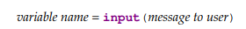
Variables
Rules to follow when naming your variables.
Variable names can contain letters, numbers, and the underscore.
Variable names cannot contain spaces.
Variable names cannot start with a number.
Case matters—for instance, temp and Temp are different.
temp = eval(input('Enter a temperature in Celsius: ‘))
print('In Fahrenheit, that is', 9/5*temp+32)

Slide 9
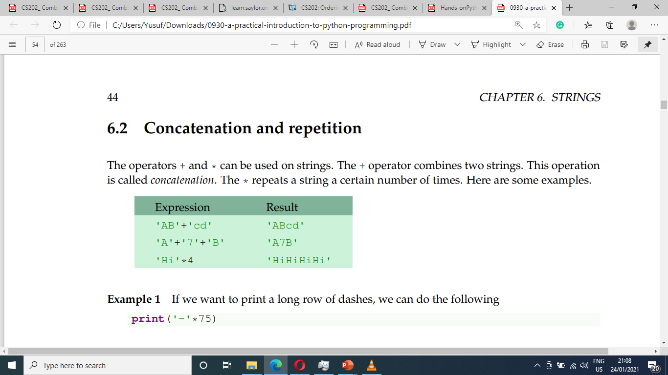
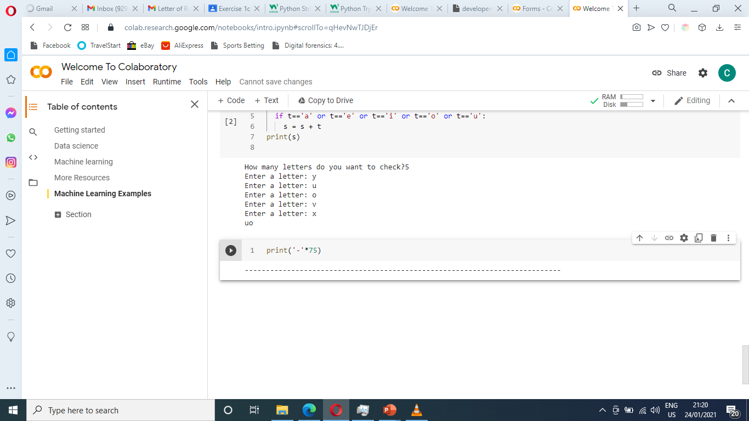
String
Creating String: s = “Hello”
string = input('Enter a string: ‘) num = eval(input('Enter a number: ‘))
Empty string: “” or ‘’
Length of string: len(‘Hello’) # 5
Concatenation and Repetition
If we want to print a long row of dashes, use print('-'*75)

Slide 10
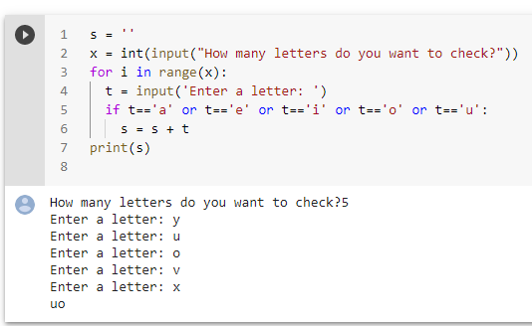
String
Notes:
Ask for number of letters and print only the consonants

Slide 11
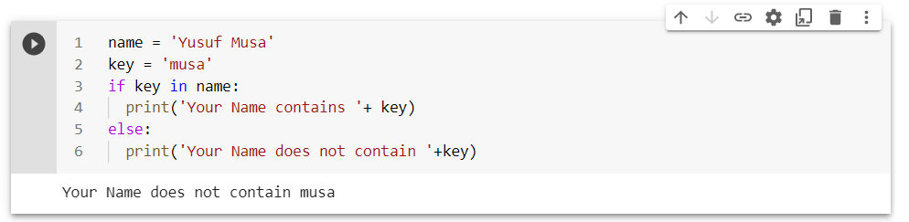
String – in operator
Notes:
Ask for number of letters and print only the consonants

Slide 12
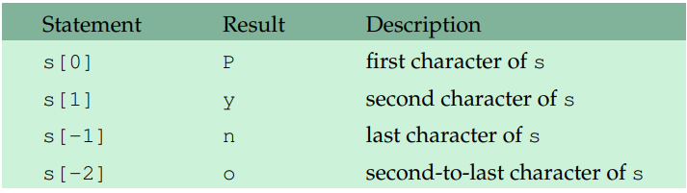
String – indexing
S = “Python”
S[12]
IndexError: string index out of range
there is only six characters
Notes:
Ask for number of letters and print only the consonants

Slide 13
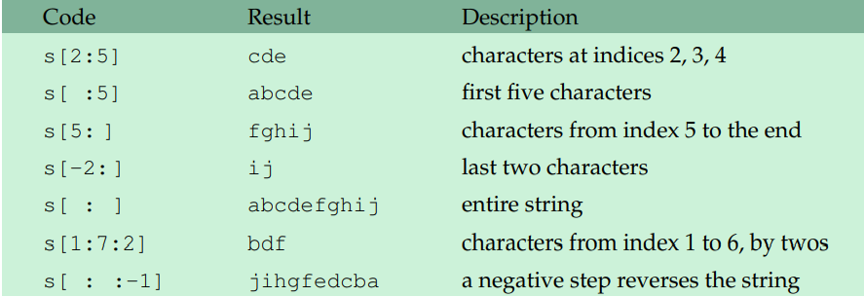
String – Slice
A slice is used to pick out part of a string.
Syntax: string_name[starting_location : ending_location+1]
Given s='abcdefghij'.
Notes:
Ask for number of letters and print only the consonants

Slide 14
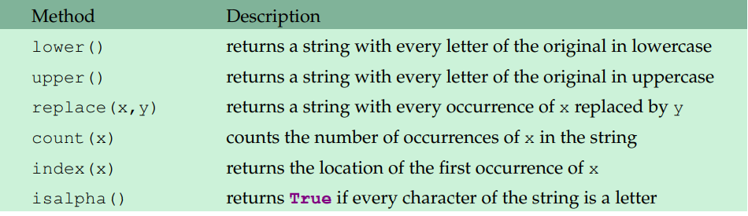
String – Methods
Methods is a functions that return information about the string or
return a new string that is a modified version of the original
Lower(), upper(), and replace() do not change the original string

Slide 15
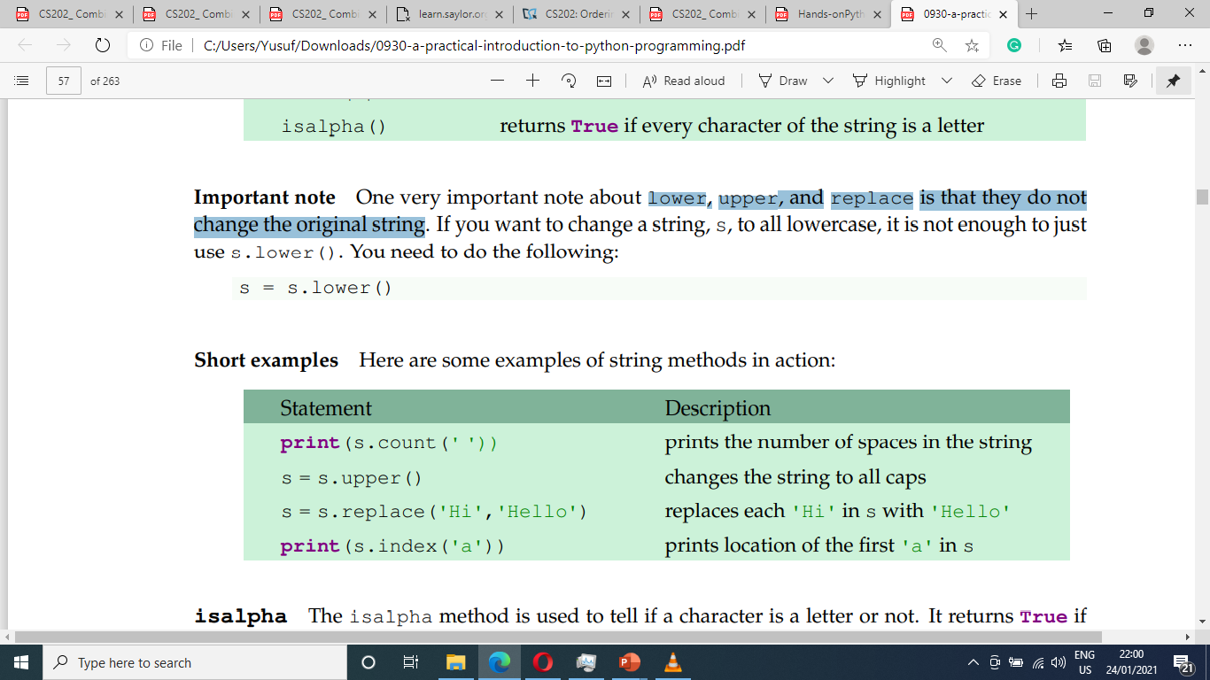
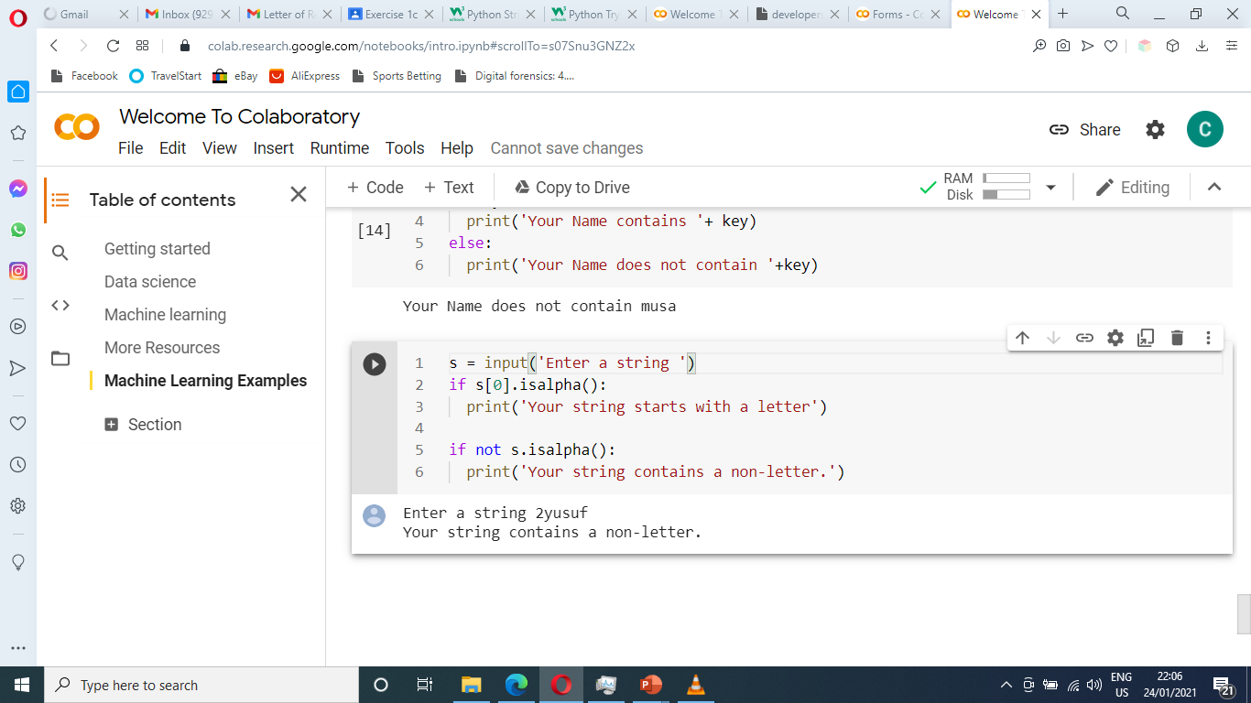
String – Methods Cont.
Isalpha() is used to tell if a character is a letter or not.

Slide 16
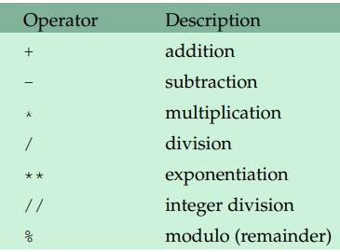
Numbers – Math Operators/order of operation
8+5 = 13
8-5 = 3
8*5 = 40
8/5 = 1.6
8**5 = 32,768
8//5 = 1
18%7 = 4
PEMDAS
Parenthesis
Exponentiation
Multiplication
Division
Addition
Sally

Slide 17
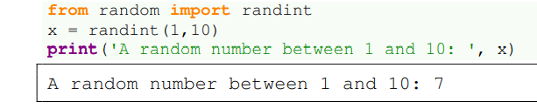
Numbers – Random Numbers
Using randint is simple: randint(a,b) will return a random integer between a and b including both a and b.
(Note that randint includes the right endpoint b unlike the range function)

Slide 18
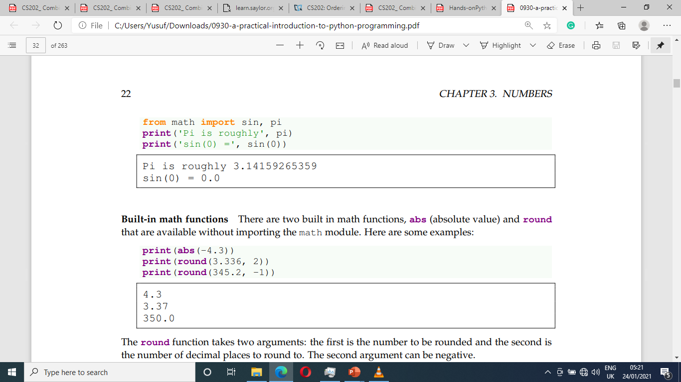
Numbers – Math functions
Python has a module called math that contains familiar math functions, including sin, cos, tan, exp, log, log10, factorial, sqrt, floor, and ceil.
There are also the inverse trig functions, hyperbolic functions, and the constants pi and e.
The round function takes two arguments: the first is the number to be rounded and the second is the number of decimal places to round to.

Slide 19
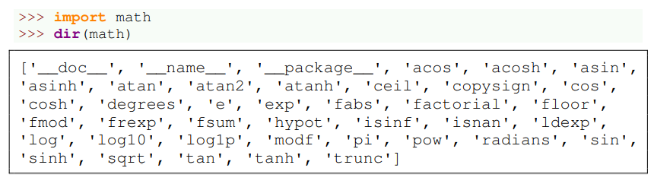
Numbers – Getting help from Python
you can type help(math.floor). Typing help(math)

Slide 20
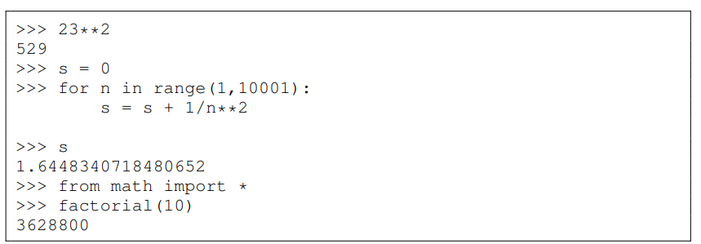
Numbers – Using the Shell as a Calculator
The Python shell can be used as a very handy and powerful calculator

Slide 21
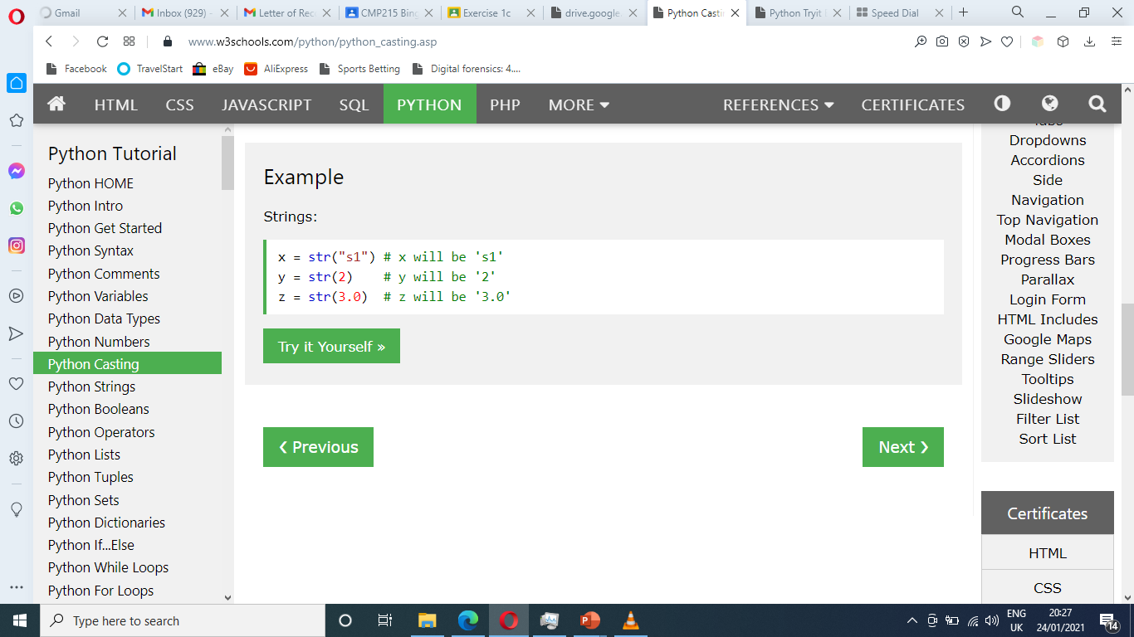
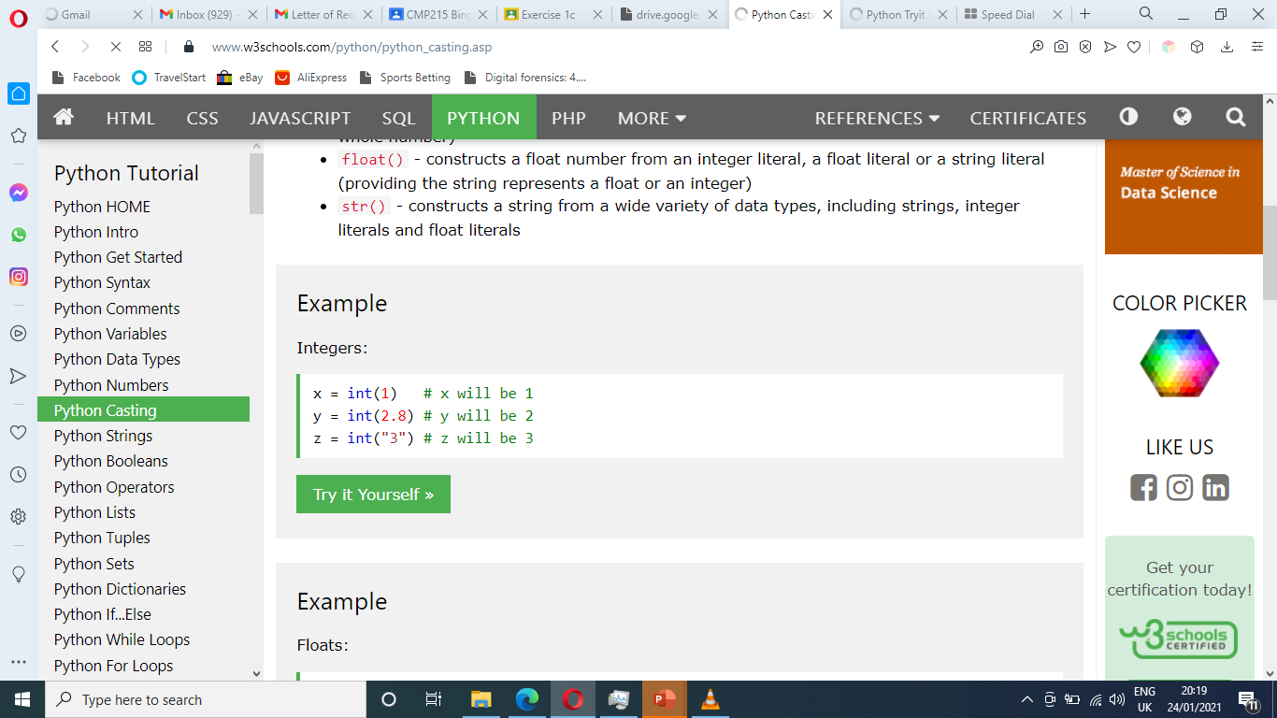
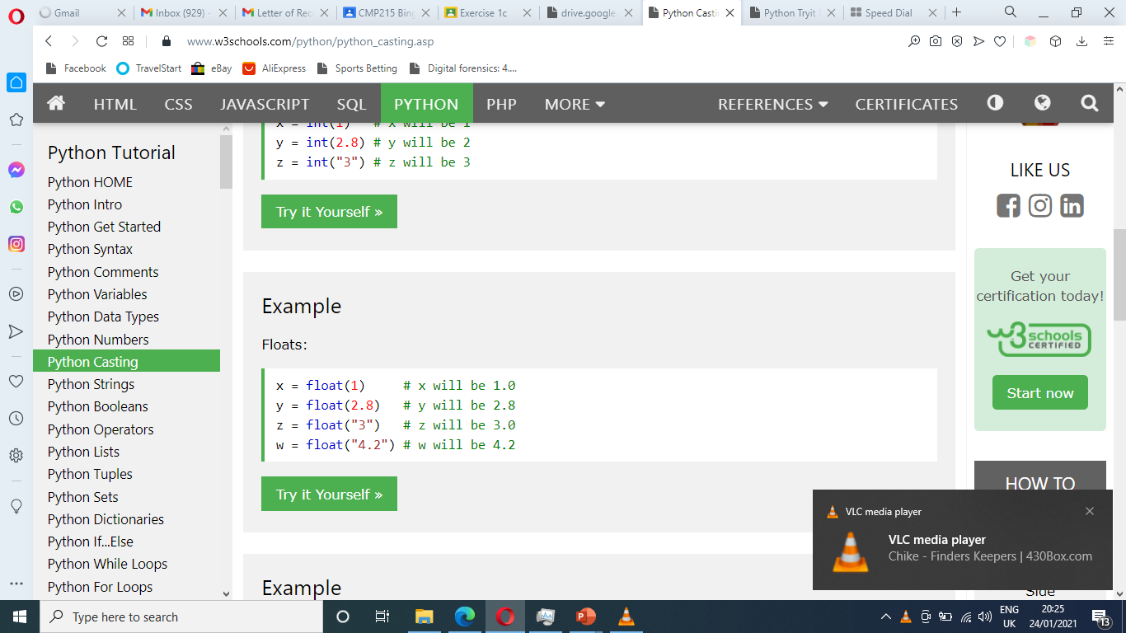
Casting
Python is an OOP, and as such it uses classes to define data types, including its primitive types
Casting in python is therefore done using constructor functions int(), float(), and str()
String
Integer
Floats

Slide 22
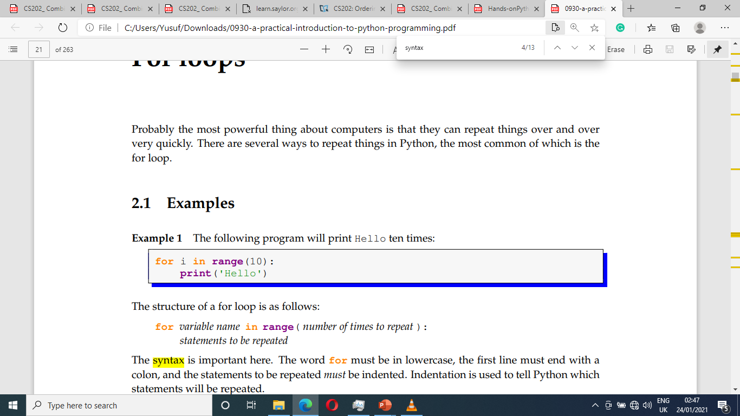
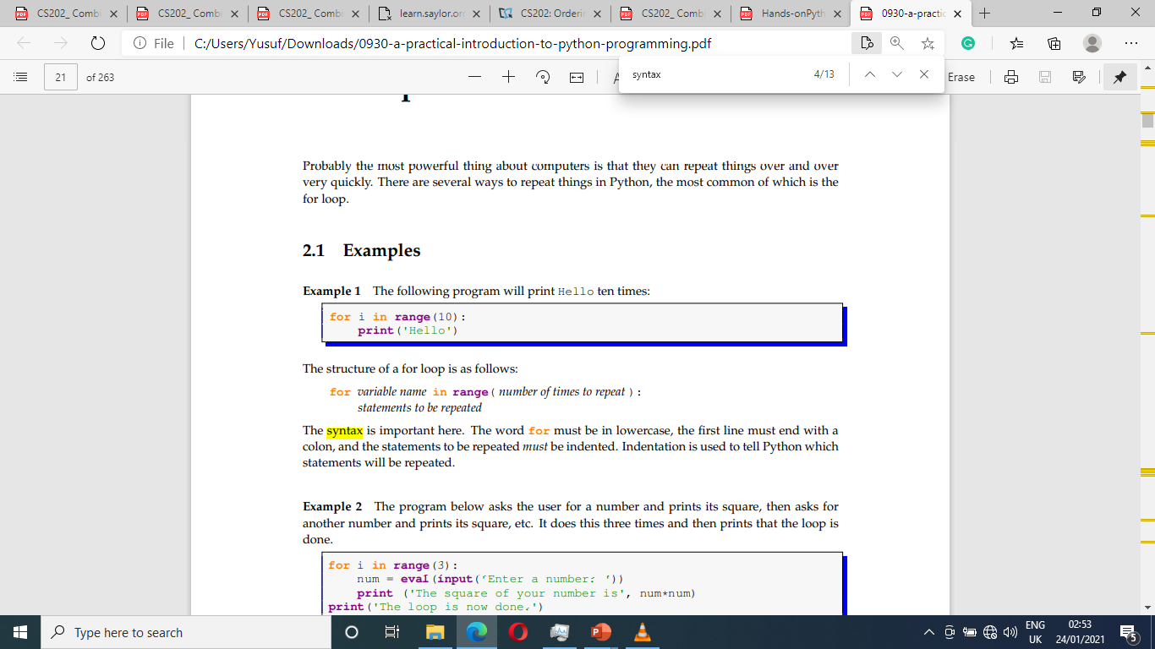
For Loops
While loop allow us to repeat things a unspecified number of times
This program will print Hello 10 times

Slide 23
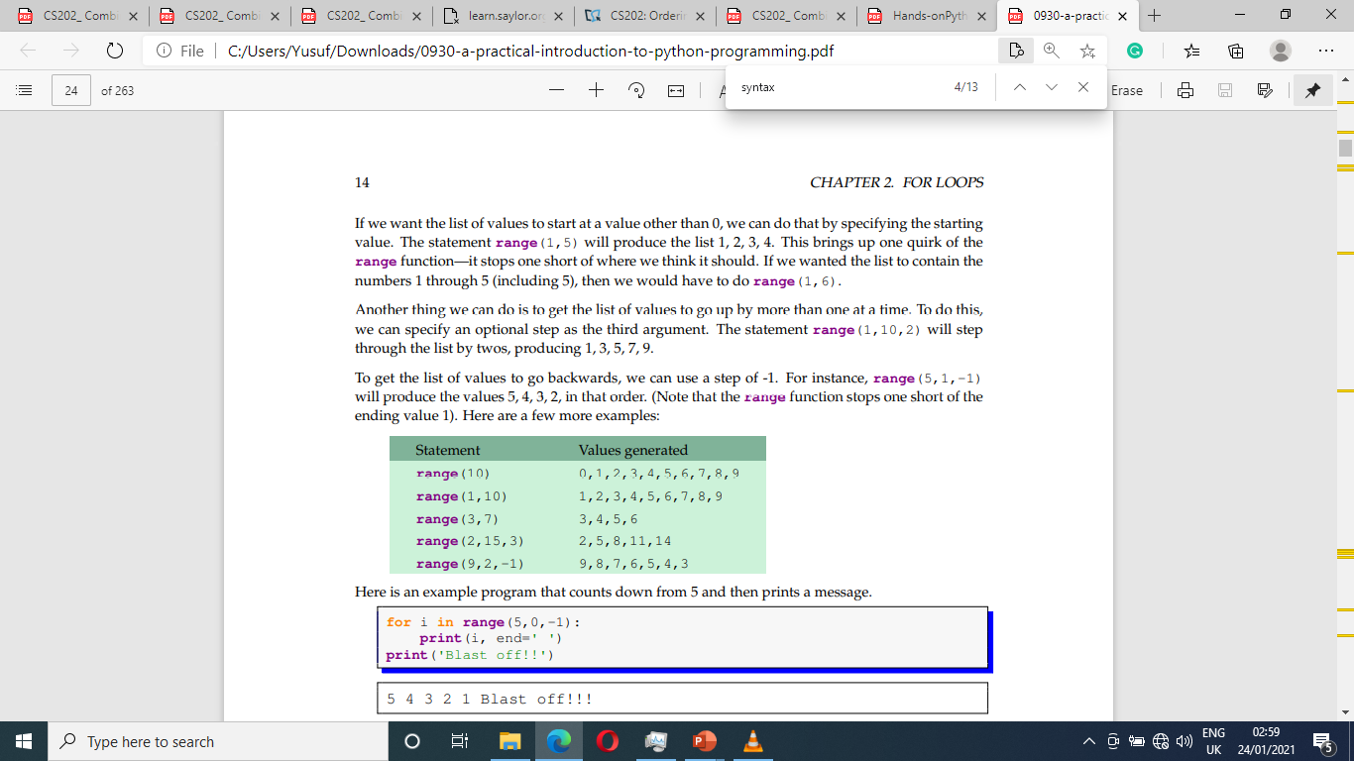
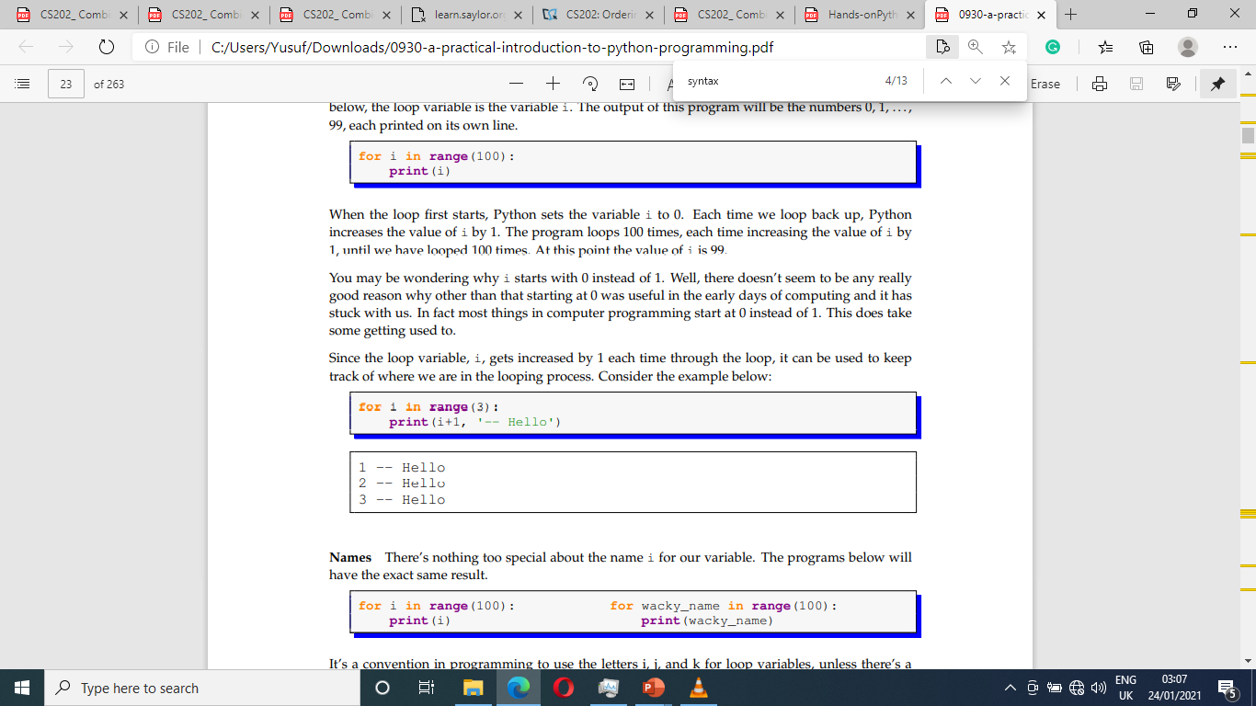
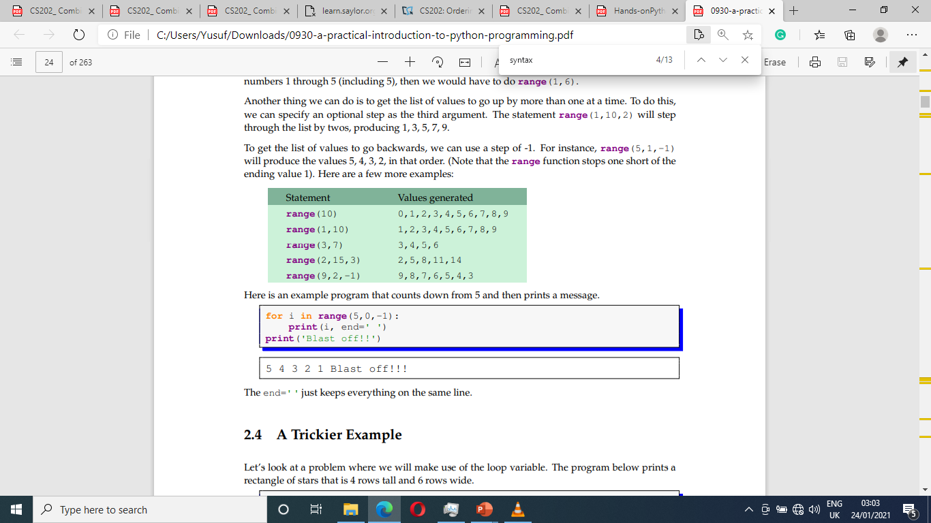
For Loops and range() function
Ex 1
Ex 2

Slide 24
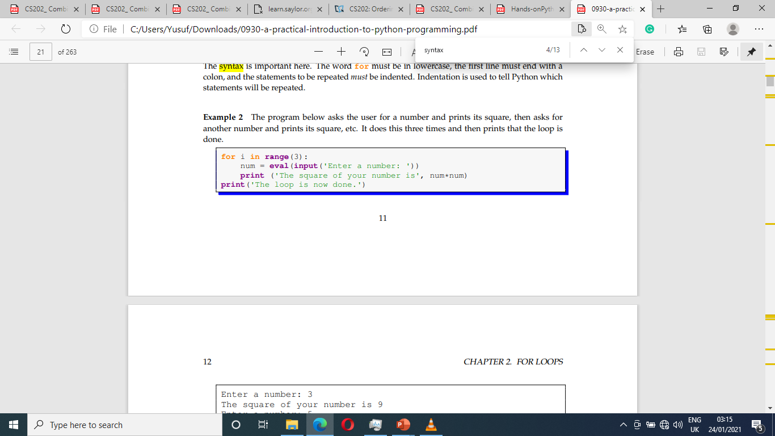
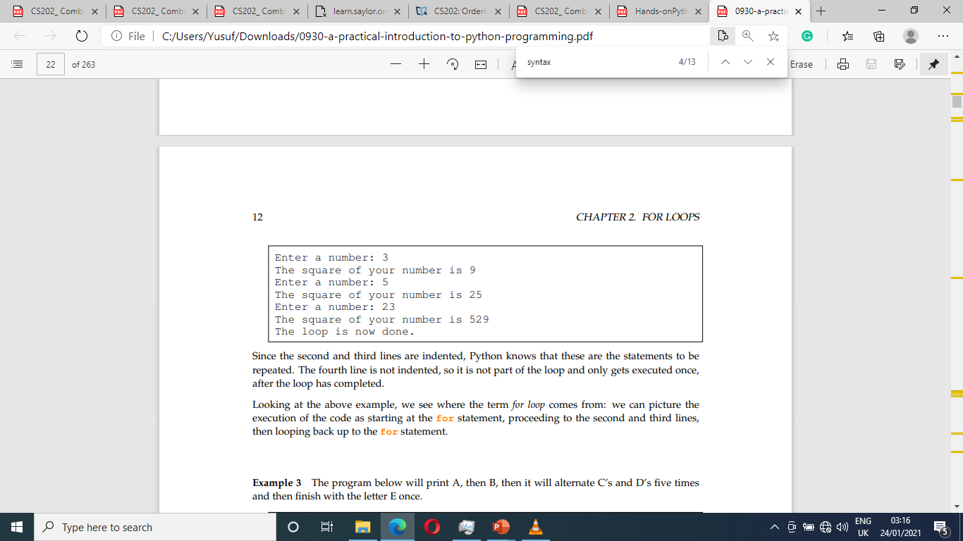
For Loops – range() function
Ex 3

Slide 25
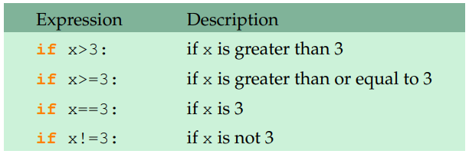
If… Conditional operators

Slide 26
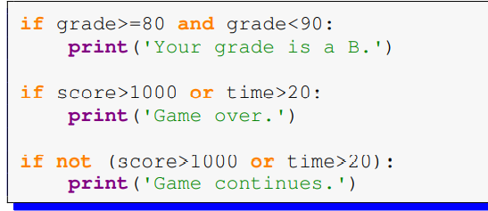
If… logical operators

Slide 27
If … Common Mistakes
S/N | Incorrect | Correct | Remark
1 | if x=1: | if x==1: | Missing double equality
2 | if x>1 and x<100 | if x>1 or x<100: | Don’t miss exchange
3 | if grade>=80 and <90 | if grade>=80 and grade<90 | Missing grade on the RHS
 | if grade>=80 and <90 | if 80<=grade<90

Slide 28
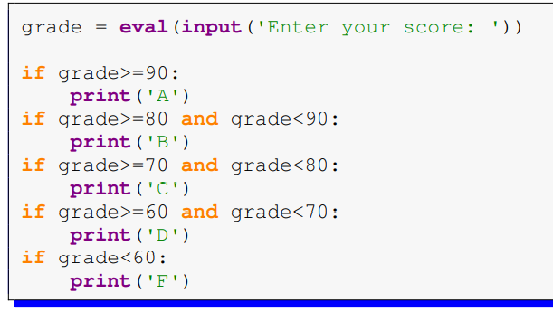
…elif… Grade Computation
Replace the 2nd, 3rd, 4th with elif and the 5th with else
Only the correct grade will be computed

Slide 29
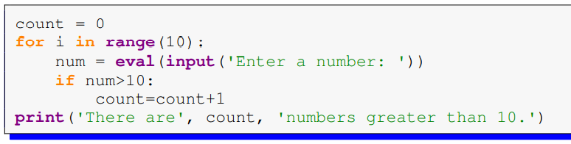
Counting Ex1
Notes:
Example 1 This program gets 10 numbers from the user and counts how many of those numbers are greater than 10.

Slide 30
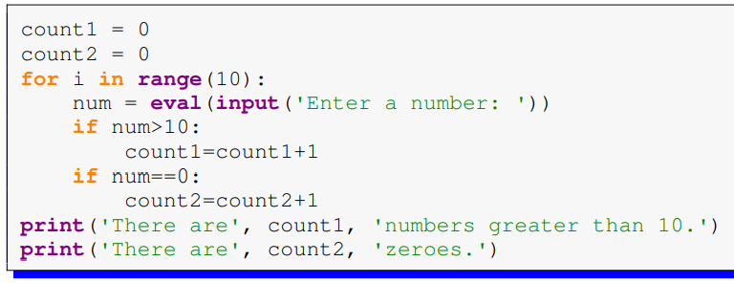
Counting Ex2
Notes:
Example 2 This modification of the previous example counts how many of the numbers the user enters are greater than 10 and also how many are equal to 0.
To count two things we use two count variables.

Slide 31
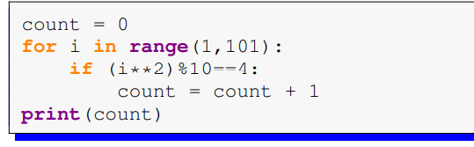
Counting Ex2
Notes:
Example 3 Next we have a slightly trickier example. This program counts how many of the squares from 1^2 to 100^2 end in a 4.

Slide 32
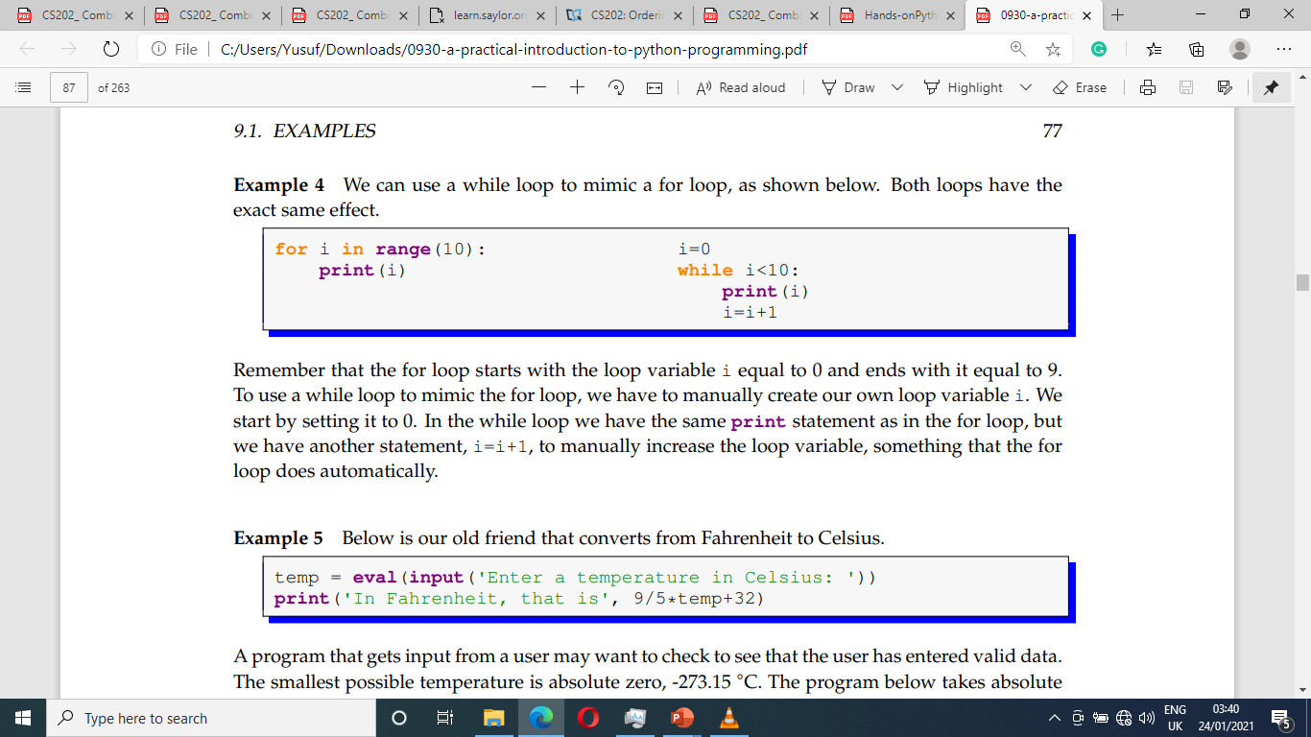
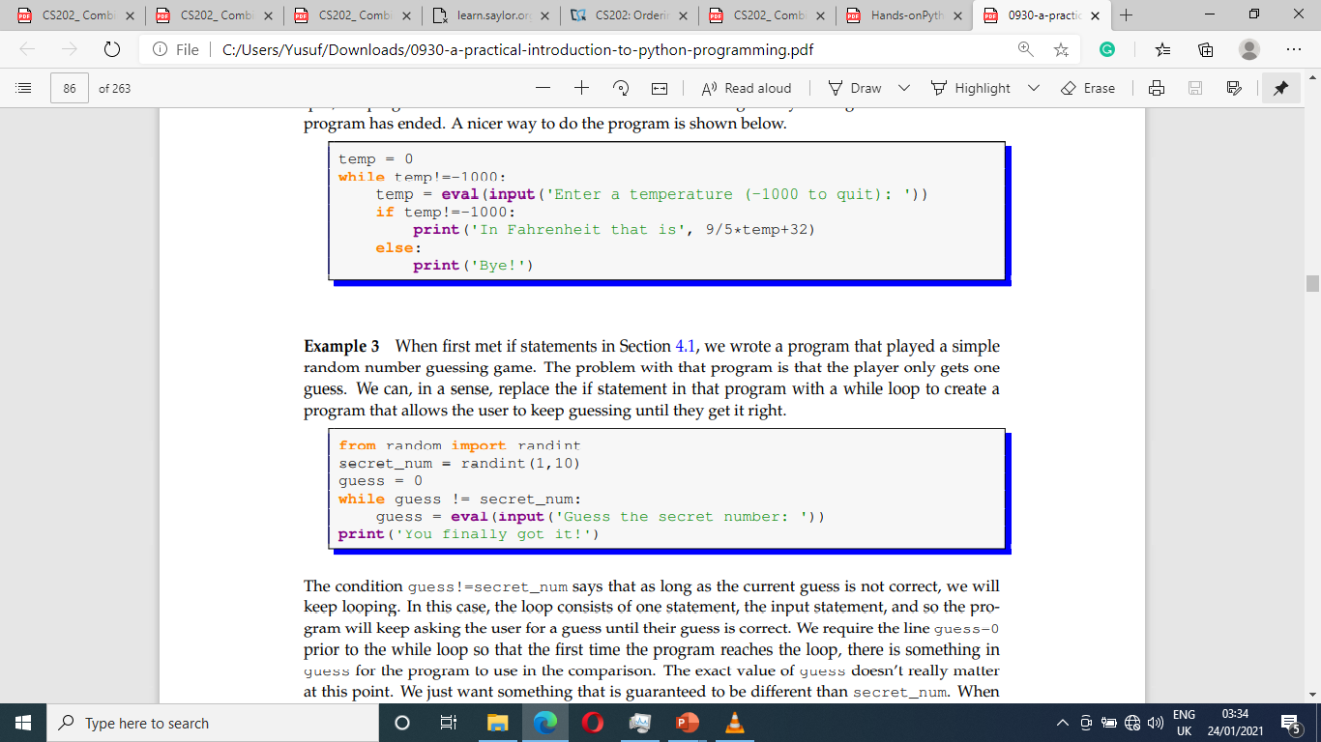
While Loops
We use while loop when we do not know ahead of time exactly how many times it has to be repeated or when to stop.
The condition guess!=secret_num means that as long as the current guess is not correct, we will keep looping.
Ex 1
Ex 2

Slide 33
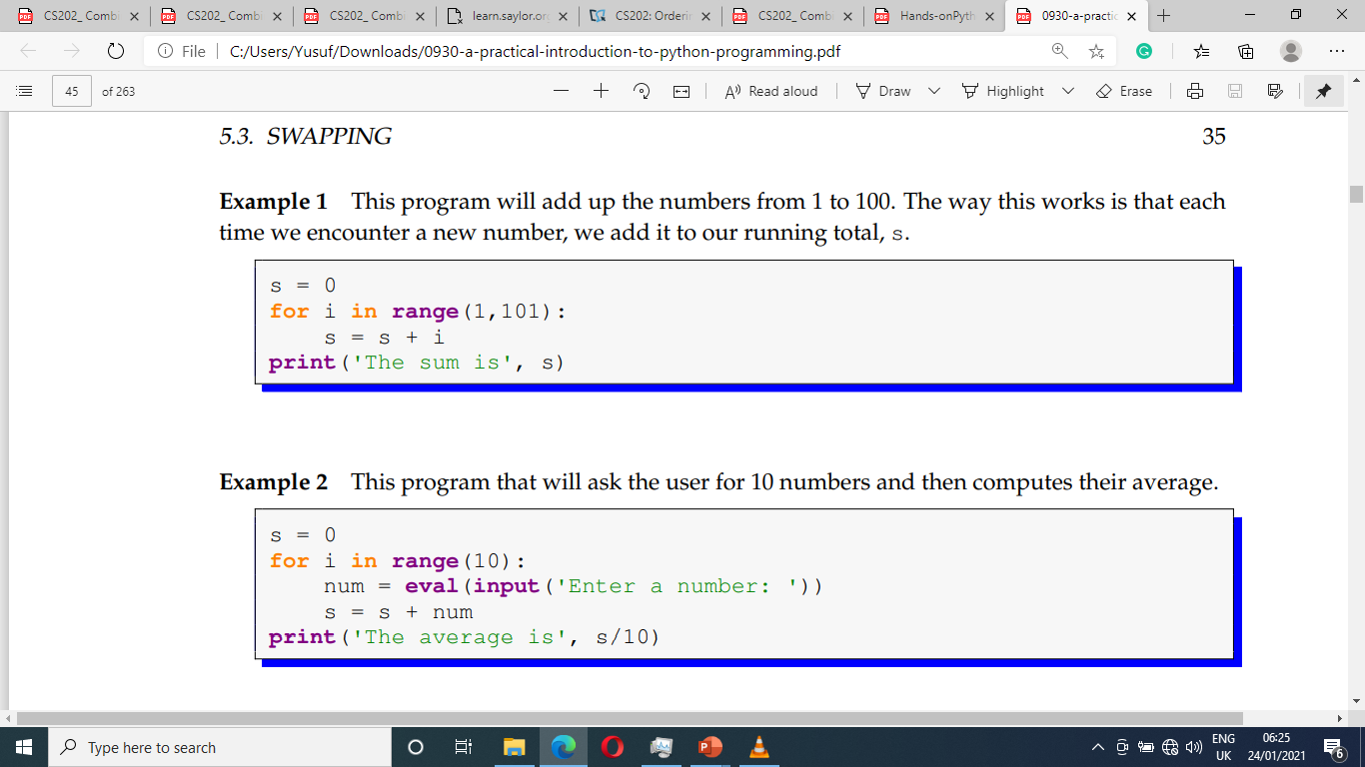
Summing
Notes:
Example 1 This program will add up the numbers from 1 to 100. The way this works is that each time we encounter a new number, we add it to our running total, s.
Example 2 This program that will ask the user for 10 numbers and then computes their average.

Slide 34
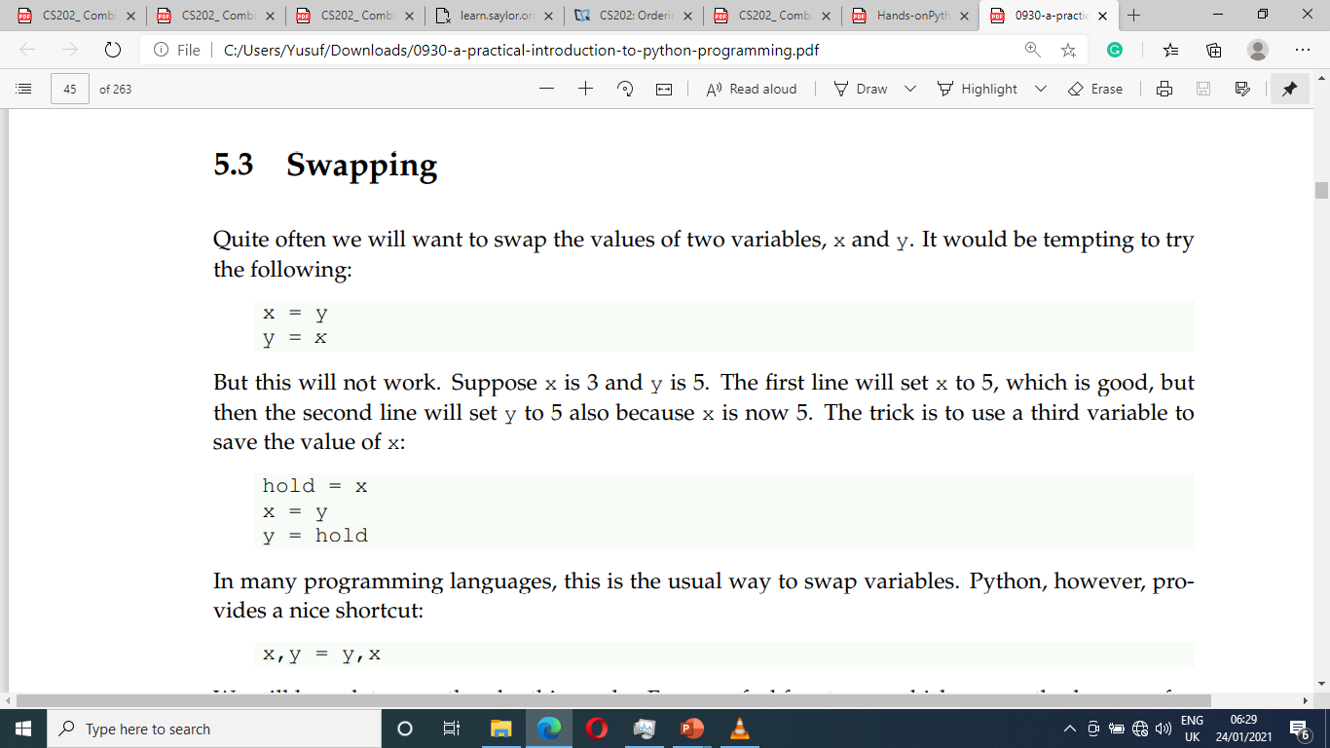
Swapping
Notes:
First: Wrong
Second Correct
Third: Only Python

Slide 35
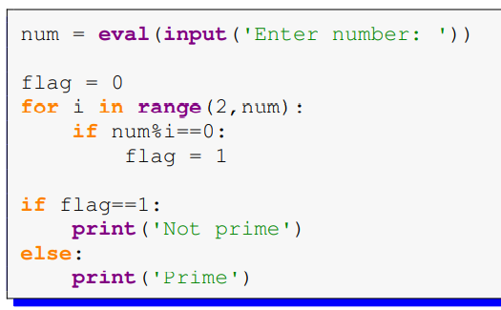
Flag variables
Used to let one part of your program know when something happens in another part of the program

Slide 36
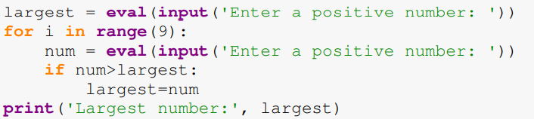
Maxes and mins
Used to let one part of your program know when something happens in another part of the program
Notes:
The key here is the variable largest that keeps track of the largest number found so far.
We start by setting it equal to the the user’s first number.
Then, every time we get a new number from the user, we check to see if the user’s number is larger than the current largest value (which is stored in largest).
If it is, then we set largest equal to the user’s number.
If, instead, we want the smallest value, the only change necessary is that > becomes

Slide 37
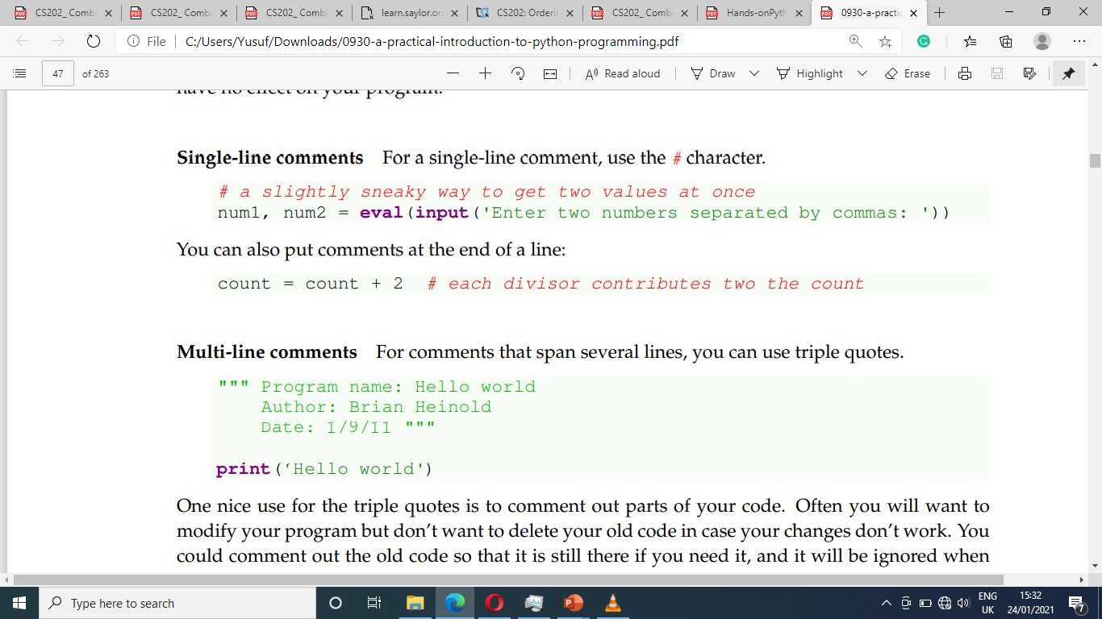
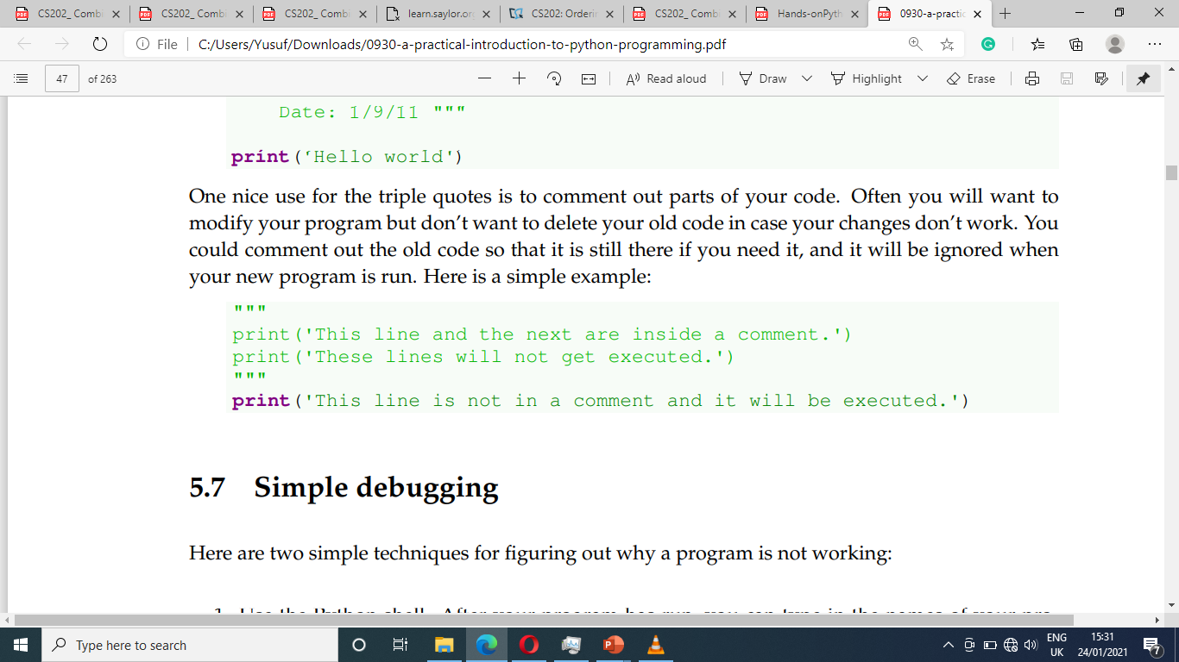
Comments
A comment is a message to someone reading your program.
Comments are often used to describe what a section of code does or how it works
Single-line comments: For a single-line comment, use the # character.
Multi-line comments: For comments that span several lines, you can use triple quotes.

Slide 38
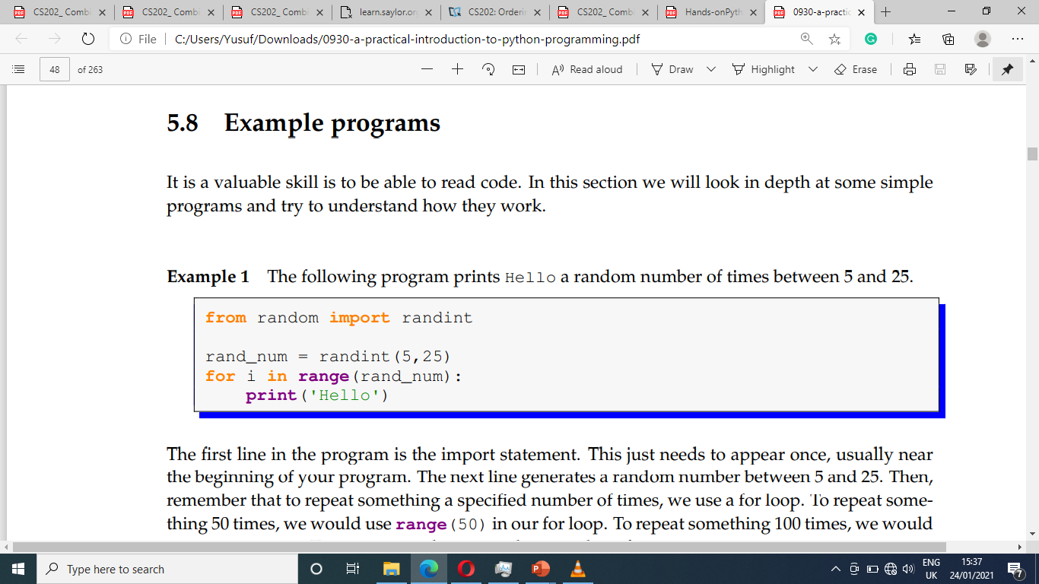
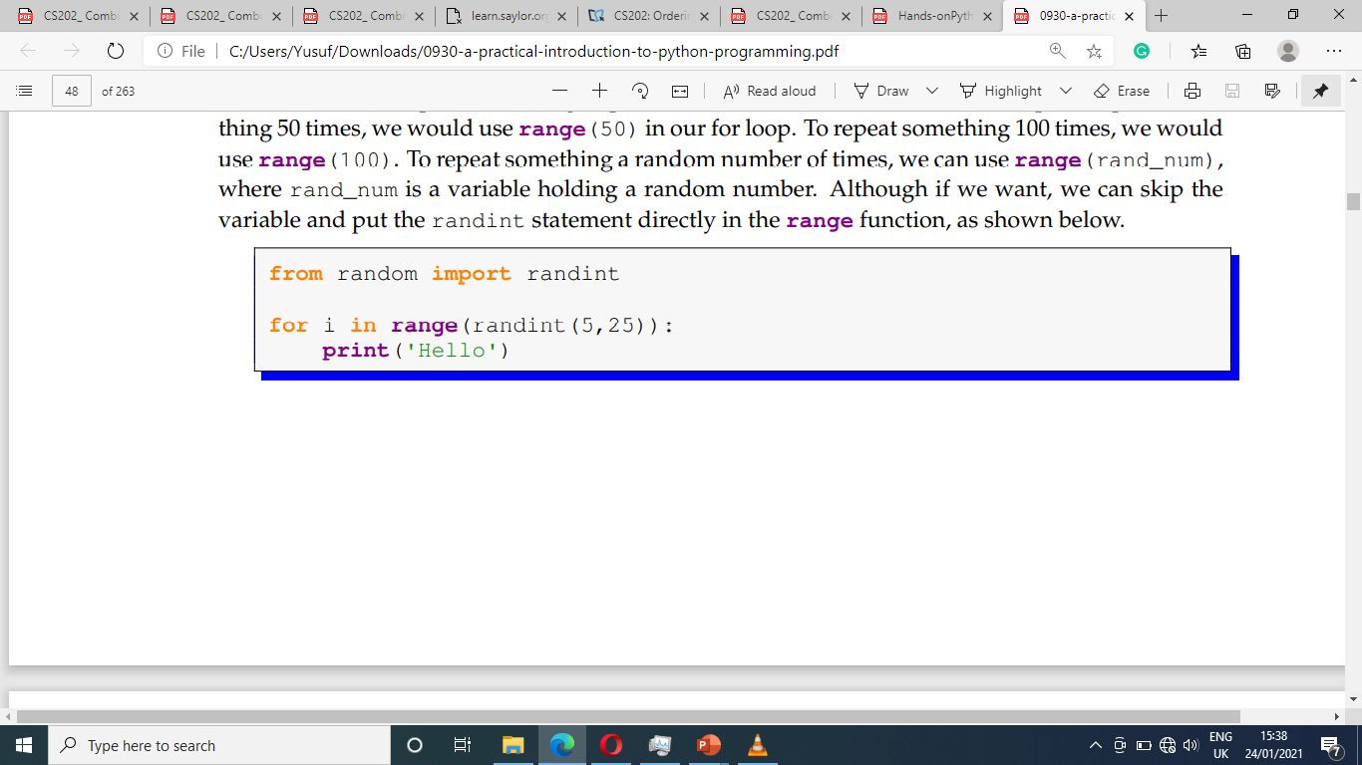
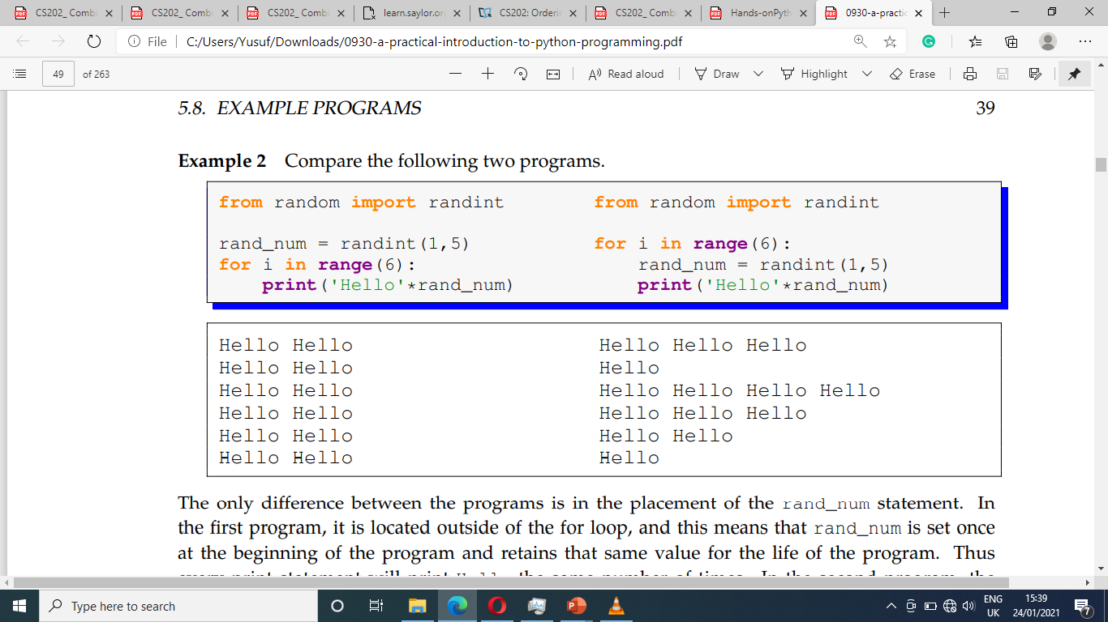
Program Comparison
Ex. 1
Ex. 2
Notes:
The next line generates a random number between 5 and 25.
Then, remember that to repeat something a specified number of times, we use a for loop.
To repeat something 50 times, we would use range(50) in our for loop.
To repeat something 100 times, we would use range(100).
To repeat something a random number of times, we can use range(rand_num), where rand_num is a variable holding a random number.
Although if we want, we can skip the variable and put the randint statement directly in the range function, as shown below.

Slide 39
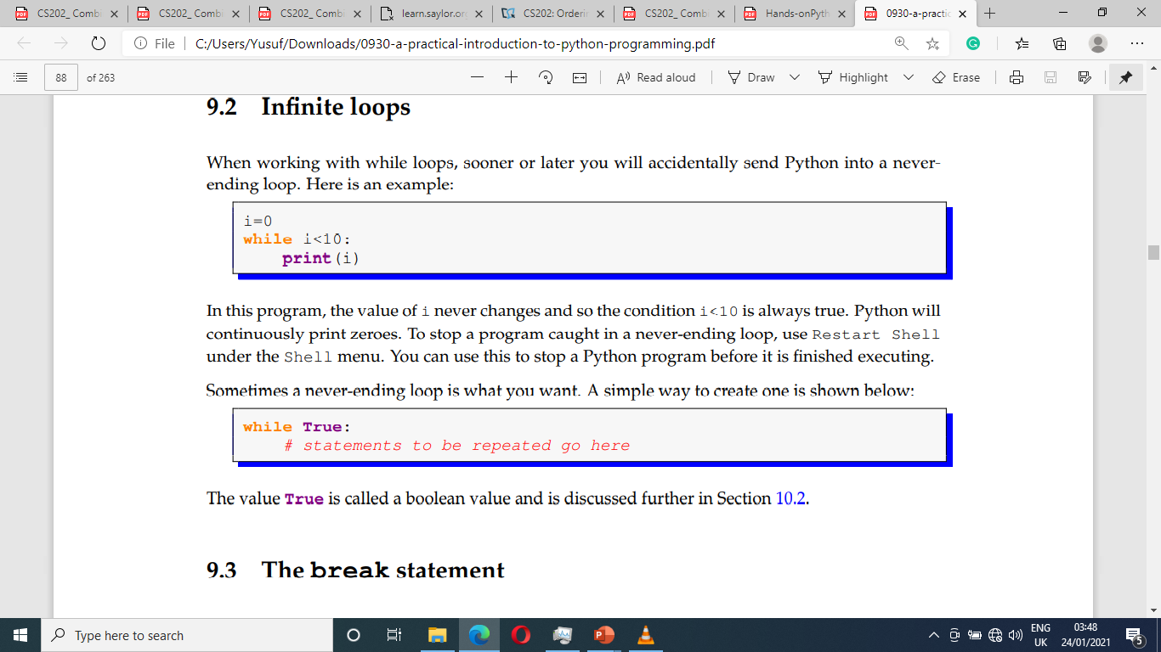
While loops – infinite loop
Sometimes a never-ending loop is what you want
In the program below, the value of i never changes (since i satisfy the condition i<10) and so the condition i<10 always remain true. This program is said to be an infinite loop

Slide 40
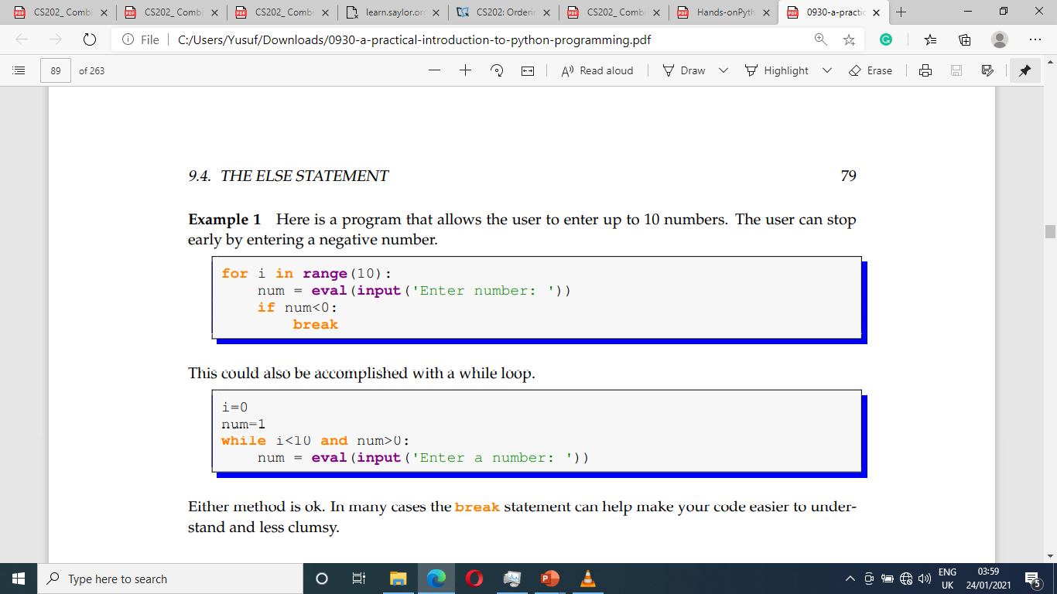
For loop with Break Statement
The break statement can be used to break out of either a for or while loop before the loop is finished.
In each of the program the user is allows to enter up to 10 numbers.
However, the user can stop early by entering a negative number

Slide 41
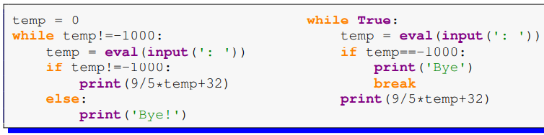
While loop and Break Statement
In each of the program the user can enter the number -1000 to quite the loop

Slide 42
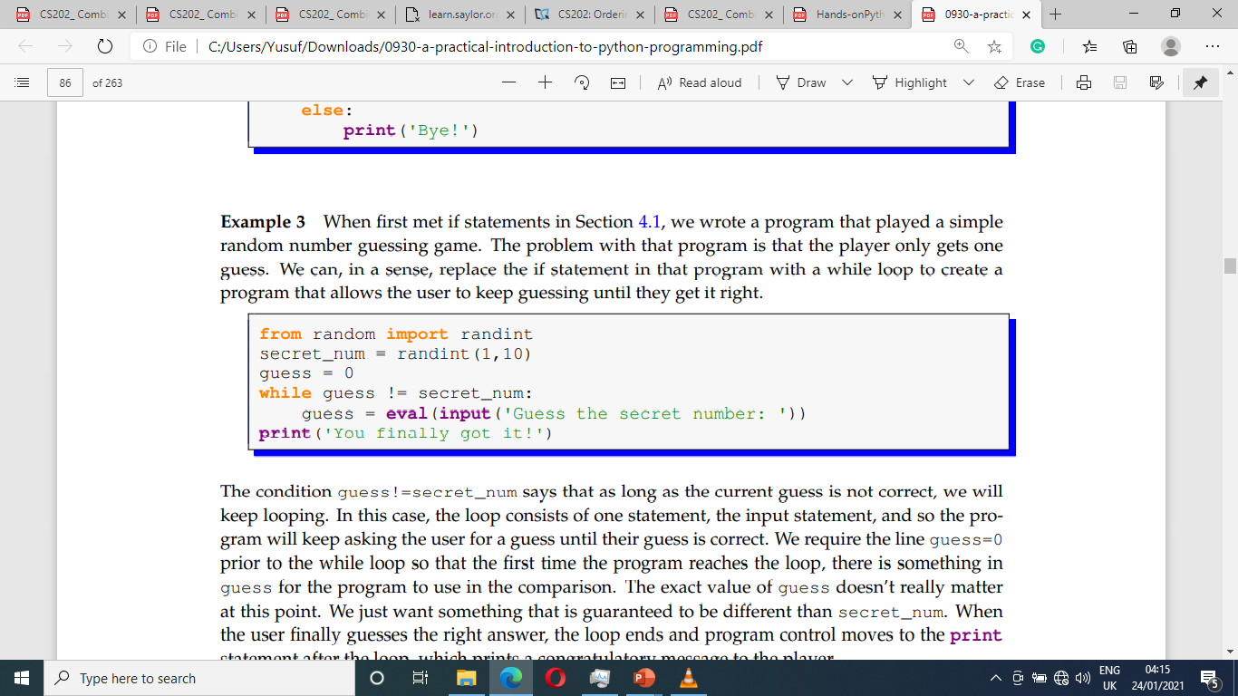
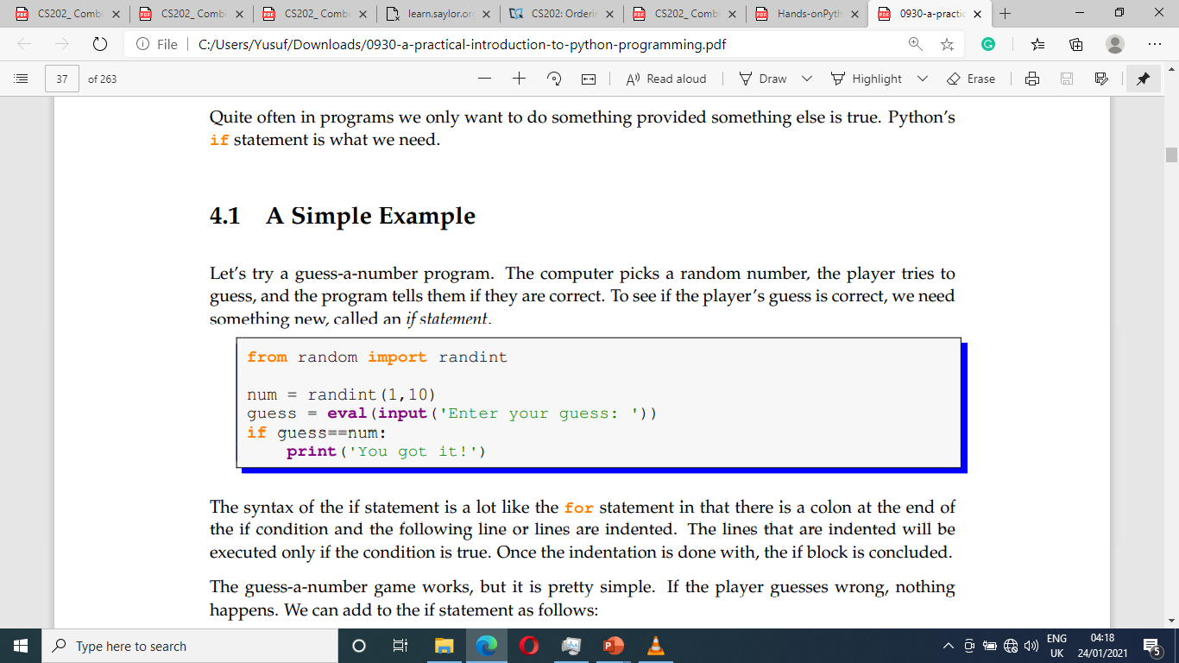
What is the diff. between the two programs?
Ex 1
Ex 2

Slide 43
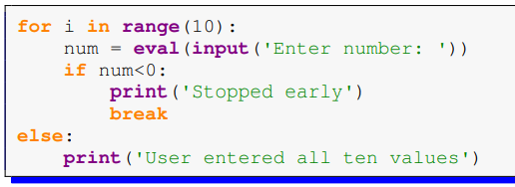
While loop - The else statement
There is an optional else that you can use with break statements.
The code indented under the else gets executed only if the loop completes without a break happening.

Slide 44
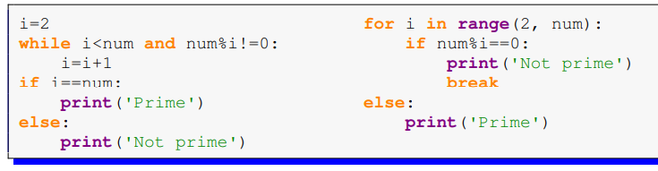
While and for loop with The else statement
Here are two ways to check if an integer number is prime.
A prime number is a number whose only divisors are 1 and itself

Slide 45
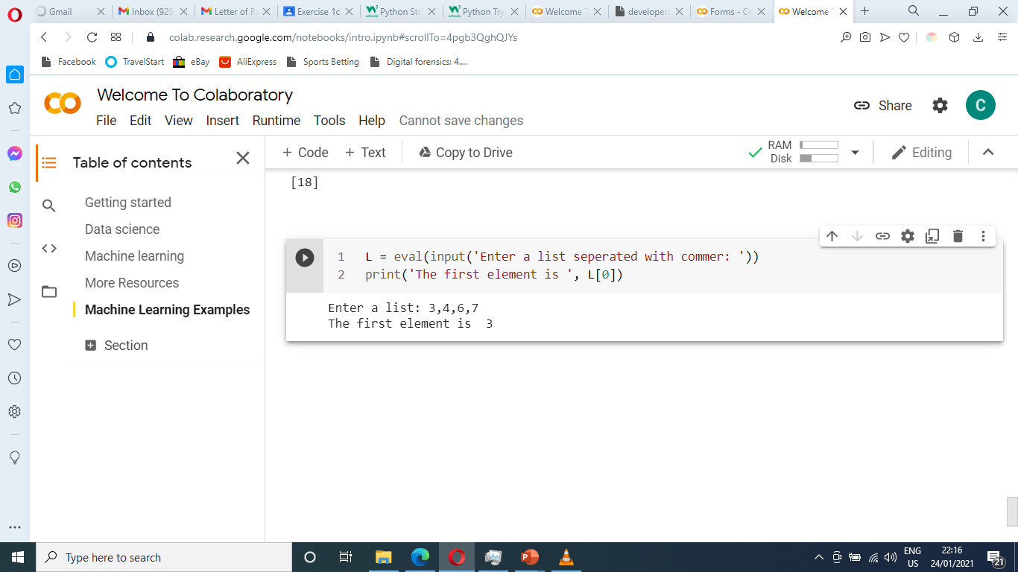

List - []
Lists can contain all kinds of datatypes, even other lists.
Similarities to strings – len(), in, index, slice, count, +, *, looping

Slide 46

List - [] cont.

Slide 47


List – Methods

Slide 48


List – Changing and appending lists

Slide 49

List – Code Examples

Slide 50


List – interactive Game

Slide 51

List – interactive Game

Slide 52

Booleans
Boolean variables in Python are variables that can take on two values, True and False
Help make your programs more readable.
Used as flag variables or to indicate options
Conditional expressions evaluate to Booleans and you can even assign them to variables. E.g. x = (6==6) will evaluate to True

Slide 53




Python Shortcuts
1. Operator Shortcuts
2. Shortcuts with conditions
3. Variable declaration and initialization Shortcut
=
or
=
4. Swapping Shortcut
=
=

Slide 54
Thank You

